Slide 1
Employee Turnover Analysis
Key Insights and Strategic Recommendations
Jie Liang

Slide 2
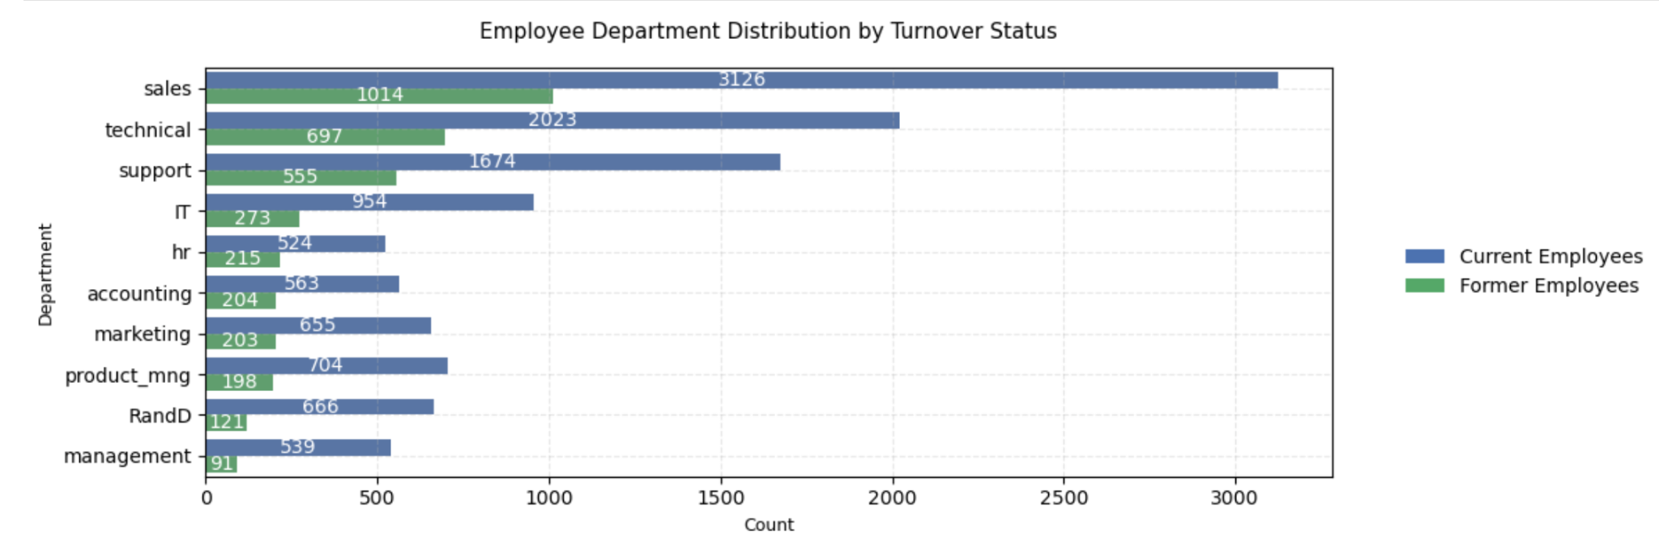
Key Findings - Overview
Department-Specific Risks:
Highest turnover: Sales, Technical, Support
Lowest turnover: Management
Overall turnover rate: 24%

Slide 3

Talent Risk Management Strategy
-Department-Specific Strategies
Sales: Compensation structure optimization
Technical: Professional development path
Support: Job satisfaction enhancement

Slide 4
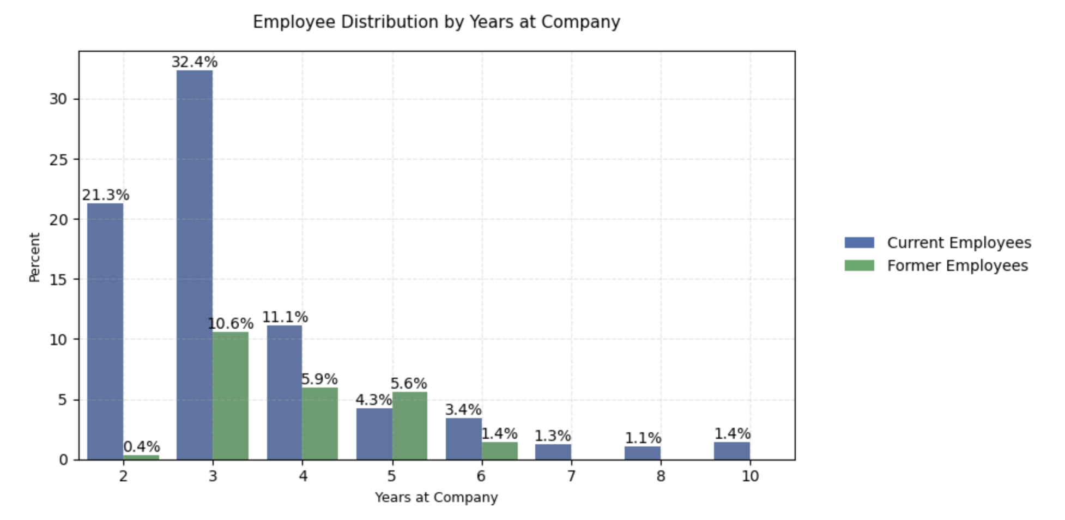
Key Findings - Tenure Analysis
Critical Time Points:
Peak turnover: 3-5 years tenure
By year 5, the proportion of departing employees (5.6%) exceeds current employees (4.3%)
The 5-year mark is a high-risk period for employee turnover
Very low retention rates (1-3%) for employees with 6-10 years tenure, which indicates significant challenges in retaining experienced talent long-term

Slide 5

Talent Retention Strategy
Focus retention efforts on employees in the 3-5 year range
Implement proactive intervention strategies before year 3
Develop clear long-term career progression paths to improve senior employee retention

Slide 6
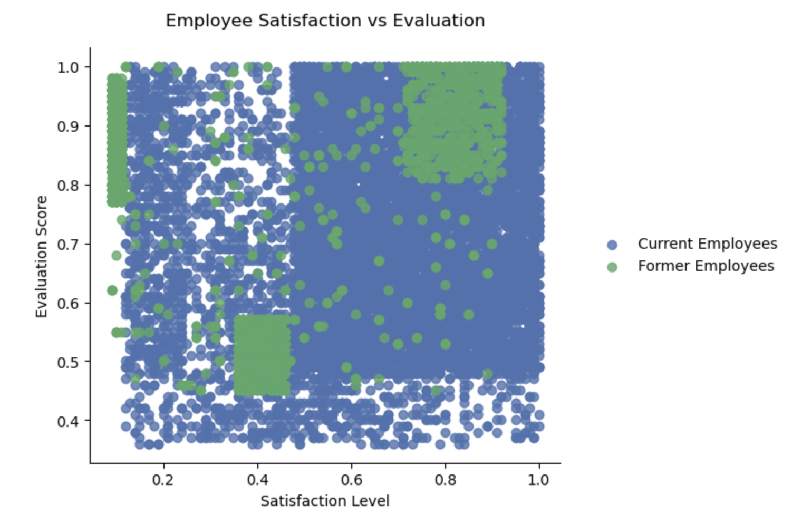
Key Findings
-Three High-Risk Employee Profiles
High Performance but Dissatisfied (Burnout Type):
Evaluation >0.75 but satisfaction <0.2
Likely overworked
Low Performance and Dissatisfied (Struggling Type):
Evaluation <0.58, satisfaction 0.35-0.45
Need intervention
High Performance and Satisfied (Opportunity Type):
Evaluation >0.8, satisfaction >0.7
Flight risk for better opportunities

Slide 7

Talent Risk Management Strategy
-Stratified Management Approach
Burnout Type: Workload adjustment, leave planning
Struggling Type: Training & development, role adjustment
Opportunity Type: Career advancement, key positions

Slide 8
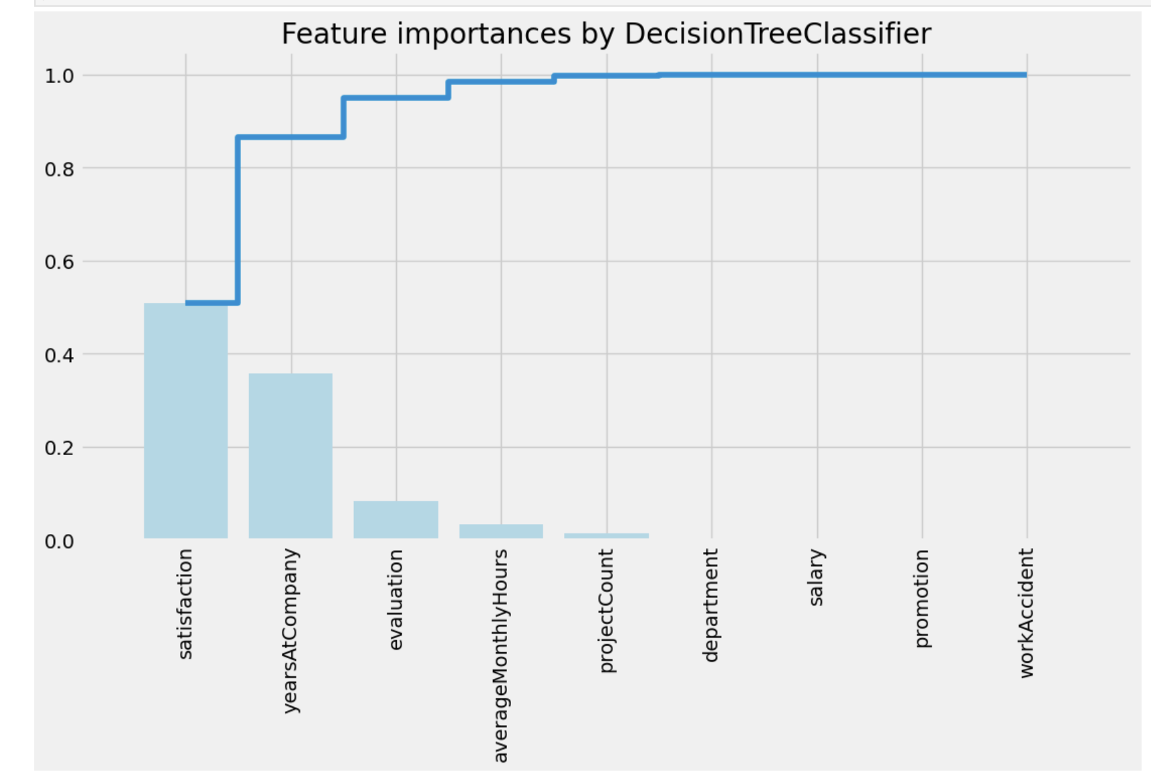
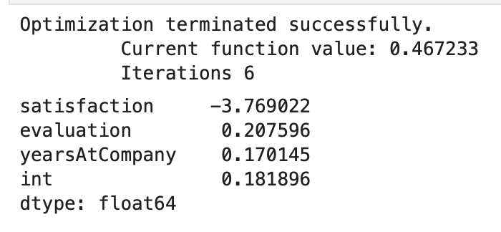
Predictive Model
Model Important Features:
Employee satisfaction (satisfaction)
tenure (yearsAtCompany)
employee performance review (evaluation)
Turnover score calculation methodology：
Employee Turnover Score = Satisfaction*(-3.769022) + Evaluation*(0.207596)+yearsAtCompany*(0.170145)+0.181896
Output (score) would predict the chance of leaving the company

Slide 9
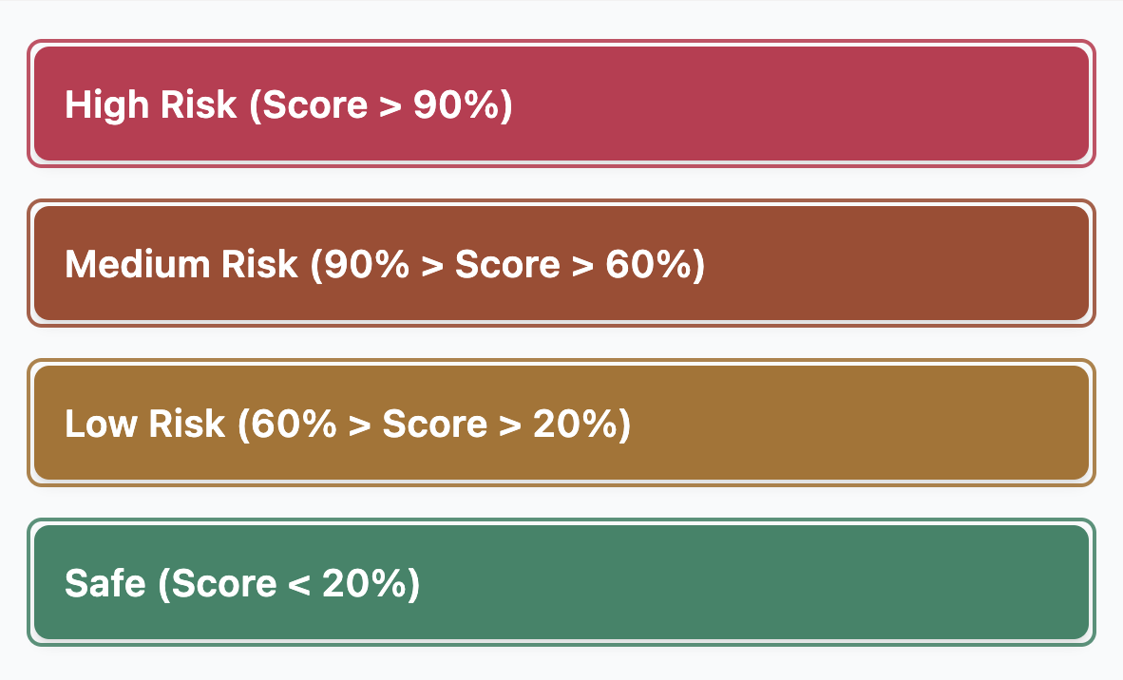
Early Warning System
Risk Score Zones:
High Risk Zone – Employees within this zone are considered to have the highest chance of turnover. Action should be taken immediately.
Medium Risk Zone – Employees within this zone are at risk of turnover. Action should be taken and monitored accordingly.
Low Risk Zone – Employees within this zone are too be taken into consideration of potential turnover. This is more of a long-term track.
Safe Zone – Employees within this zone are considered safe.
By identifying high-risk employees, we can implement targeted retention programs.

Slide 10

Early Warning System-Example
If one employee was in these employee values into the equation:
Satisfaction: 0.7
Evaluation: 0.8
YearsAtCompany: 3
Employee Turnover Score = (0.7)*(-3.769022) + (0.8)*(0.207596)+(3)*(0.170145)+0.181896 = 14%
Result: The employee has 14% chance of leaving the company. This information informs us that the employee is in the safe zone that he/she would be considered not likely to leave.

Slide 11

Action Plan
Short-term Actions (1-3 months):
1:1 interviews with high-risk employees
Department manager training program
Regular satisfaction survey implementation

Slide 12

Action Plan
Long-term Initiatives (6-12 months):
Compensation structure optimization
Career path enhancement
Performance evaluation system improvement

